Slide 1
Rollover Risk and Credit Risk—ZHIGUO HE and WEI XIONG
Presented by Yuxiu Ma

Slide 2
AGENDA
Introduction
I. The Model
II. Valuation and Default Boundary
III. Market Liquidity and Endogenous Default
IV. Optimal Leverage
Ⅴ. Conclusion
Ⅵ. My opinion

Slide 3
Introduction
Credit Spread reflects liquidity premium and default premium.
Liquidity premium and default premium are not independent, but instead interact with each other.
Deterioration in liquidity will increase default premium through rollover risk. This interaction originates from the conflict of interest of equity holders and debt holders.
Shorter maturity for all bonds issued by a firm exacerbates its rollover risk
Notes:
It is widely recognized that the credit spread reflects not only a default premium determined by the firm’s credit risk but also a liquidity premium due to illiquidity of the secondary debt market
2. However, academics and policy makers tend to treat both the default premium and the liquidity premium as independent, and thus ignore interactions between them
3. This intervention can probably help us explain why in The financial crisis of 2007 to 2008, debt market liquidity caused severe financing difficulties for many financial firms, which in turn exacerbated their credit risk.
4. The major logical intuition of this paper is:…..
5. This paper also highlights the role that maturity plays in bond rollover risk.

Slide 4
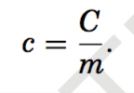
I. The Model
A. Firm Assets
B. Stationary Debt Structure
we assume that the firm commits to a stationary debt structure denoted by (C, P, m). and expirations of the bonds are uniformly spread out over time.
Each unit thus has a principal value of
and an annual coupon payment of
Notes:
1. We build on the structural credit risk model of Leland and Toft (1996) by adding an illiquid secondary bond market.
where r is the constant risk-free rate,1 δ is the firm’s constant cash payout rate, σ is the constant asset volatility, and {Zt : 0 ≤ t < ∞} is a standard Brownian motion, representing random shocks to the firm’s fundamental. Throughout the paper, we refer to Vt as the firm’s fundamental.
Each bond has maturity m, and expirations of the bonds are uniformly spread out over time. This implies that during a time interval (t, t + dt) , a fraction 1 dt of the bonds matures and m needs to be rolled over. We measure the firm’s bonds by m units. Each unit thus has a principal value of

Slide 5
I. The Model
C. Debt Rollover and Endogenous Bankruptcy
δ
Vt
*MODEL KEY FEATURE: The equity value is jointly determined by the firm’s fundamental and expected future rollover gains/losses.
D. Secondary Bond Markets
Each bond investor is exposed to an idiosyncratic liquidity shock, which arrives according to a Poisson occurrence with intensity ξ.
Upon the arrival of the liquidity shock, the bond investor has to exit by selling his bond holding in the secondary market at a fractional cost of k.
Notes:
When the firm issues new bonds to replace maturing bonds, the market price of the new bonds can be higher or lower than the required principal payments of the maturing bonds. Equity holders are the residual claimants of the rollover gains/losses. For simplicity, we assume that any gain will be immediately paid out to equity holders and any loss will be paid off by issuing more equity at the market price. Thus, over a short time interval (t, t + dt), the net cash flow to equity holders (omitting dt) is
The first term is the firm’s cash payout. The second term is the after-tax coupon payment, where π denotes the marginal tax benefit rate of debt. The third and fourth terms capture the firm’s rollover gain/loss by issuing new bonds.
to replace maturing bonds. In this transaction, there are dt units of bonds maturing. The maturing bonds require a principal payment of pdt. The market value of the newly issued bonds is d(Vt,m)dt. When the bond price d(Vt,m) drops, equity holders have to absorb the rollover loss [d(Vt , m) − p]dt to prevent bankruptcy.
When the firm issues additional equity to pay off the rollover loss, the equity issuance dilutes the value of existing shares. As a result, the rollover loss feeds back into equity value by changing the payout ratio. This is a key feature of the model.
Here we ignore any additional frictions in the equity market such as transaction costs and asymmetric information.

Slide 6
II. Valuation and Default Boundary
A. Debt Value
two boundary conditions
Notes:
We first derive bond valuation by taking the firm’s default boundary VB as given. Recall that d(Vt,τ;VB) is the value of one unit of a bond with a time- to-maturity of τ < m, an annual coupon payment of c, and a principal value of
p. We have the following standard partial differential equation for the bond value:
The left-hand side rd is the required (dollar) return from holding the bond. There are four terms on the right-hand side, capturing expected returns from holding the bond. The first term is the coupon payment. The second term is the loss caused by the occurrence of a liquidity shock. The liquidity shock hits with probability ξdt. Upon its arrival, the bond holder suffers a transaction cost of kd(Vt,τ) by selling the bond holding. Explain what is liquidity premium—ξk. The last three terms capture the expected value change due to a change in time-to-maturity τ (the third term) and a fluctuation in the value of the firm’s assets Vt (the fourth and fifth terms)
We have two boundary conditions to pin down the bond price based on equation
We have two boundary conditions to pin down the bond price based on equa- tion (5). At the default boundary VB, bond holders share the firm’s liquidation value proportionally. Thus, each unit of bond gets FIRST CONDITION
When τ = 0, the bond matures and its holder gets the principal value p if the
firm survives:

Slide 7
II. Valuation and Default Boundary
A. Debt Value
the bond’s value
（8）
the bond yield y
Credit spread
y-r
Notes:
Equation (5) and boundary conditions (6) and (7) determine the bond’s value:
The bond yield is typically computed as the equivalent return on a bond conditional on its being held to maturity without default or trading. Given the bond price derived in equation (8), the bond yield y is determined by solving

Slide 8
II. Valuation and Default Boundary
B. Equity Value and Endogenous Default Boundary
Boundary condition:
VB: E (VB) = 0.
PROPOSITION 1: The equity value E (Vt ) is given in equation (A7) of Appendix A.
The endogenous bankruptcy boundary VB is given by
Notes:
we directly compute equity value E(Vt) through the following differential equation:
The left-hand side is the required equity return. This term should be equal to the expected return from holding the equity, which is the sum of the terms on the right-hand side.
The first two terms (r − δ) Vt EV + 1 σ 2 Vt2 EV V capture the expected change 2
in equity value caused by a fluctuation in the firm’s asset value Vt.
The third term δVt is cash flow generated by the firm per unit of time.
The fourth term (1 − π ) C is the after-tax coupon payment per unit of time.
The fifth and sixth terms d(Vt,m)− p capture equity holders’ rollover gain/loss from paying off maturing bonds by issuing new bonds at the market price.
Limited liability of equity holders provides the following boundary condition at VB: E (VB) = 0.

Slide 9
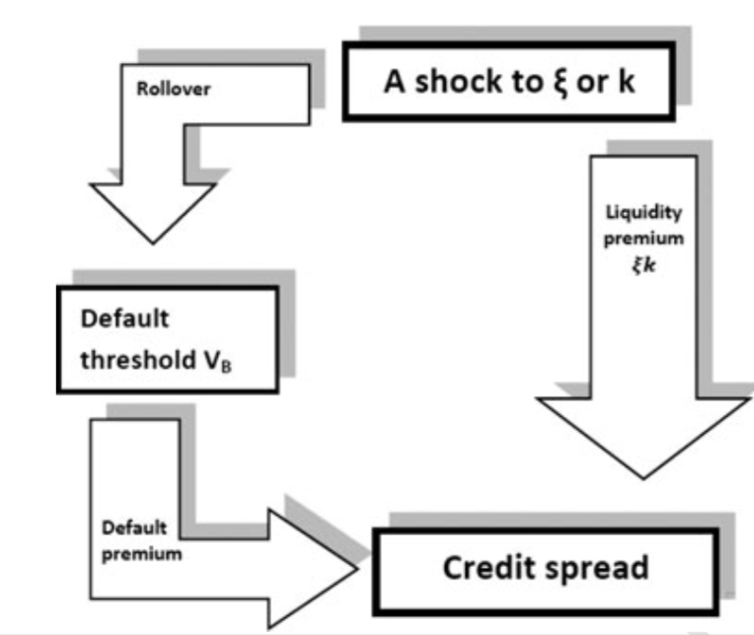
III. Market Liquidity and Endogenous Default
Factors to change market liquidity over time.
The effect of market liquidity shock on firms’ credit spreads.
the bond’s value
（8）
Notes:
Many factors can cause bond market liquidity to change over time. Increased uncertainty about a firm’s fundamental can cause the cost of trading its bonds (i.e., k) to go up; less secured financing due to redemption risk faced by open-end mutual funds and margin risk faced by leveraged institutions (i.e., deteriora- tion in funding liquidity a la Brunnermeier and Pedersen (2009)) can also cause bond investors’ liquidity shock intensity (i.e., ξ) to rise. Through the increase of one or both of these variables, the liquidity premium ξ k will increase. In this section we analyze the effect of such a shock to bond market liquidity on firms’ credit spreads.
Figure 1 illustrates two key channels for a shock to ξ or k to affect a firm’s credit spread. Besides the direct liquidity premium channel mentioned above, there is an indirect rollover risk channel. The increased liquidity premium sup- presses the market price of the firm’s newly issued bonds and increases equity holders’ rollover losses. As a result, equity holders become more reluctant to keep the firm alive even though the falling bond price is caused by deteriora- tion in market liquidity rather than the firm’s fundamental. In other words, the default threshold VB rises, which in turn leads to a greater default premium in the credit spread. This indirect rollover risk channel is the main focus of our analysis.
As ξ and k affect the bond price in equation (8) symmetrically through the liquidity premium, we use an increase in ξ to illustrate the effect.

Slide 10
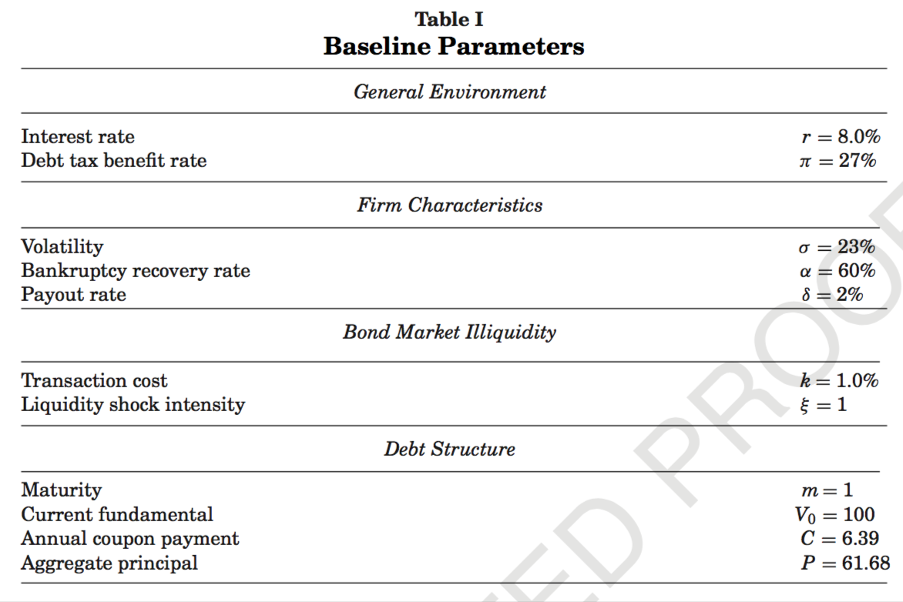
III. Market Liquidity and Endogenous Default
A. Model Parameters
Notes:
To facilitate our analysis, we use the set of baseline parameters given in Table I. We choose these parameters to be broadly consistent with those used in the literature to calibrate standard structural credit risk models. We set the risk-free rate r to 8%, which is also used by Huang and Huang (2003). We use a debt tax benefit rate of π = 27% based on the following estimate. While tax rate of bond income is 35%, many institutions holding corporate bonds enjoy a tax exemption. We use an effective bond income tax rate of 25%. The formula given by Miller (1977) thus implies a debt tax benefit of 1 − (1−35%)(1−15%) = 26.5%, 35 1−25%,where 35% is the marginal corporate tax rate and 15% is the marginal capital gains tax rate.

Slide 11
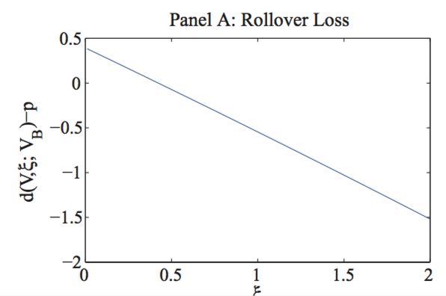
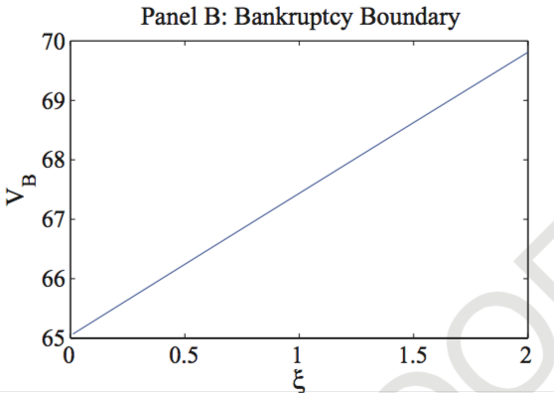
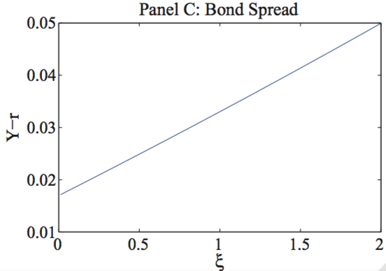
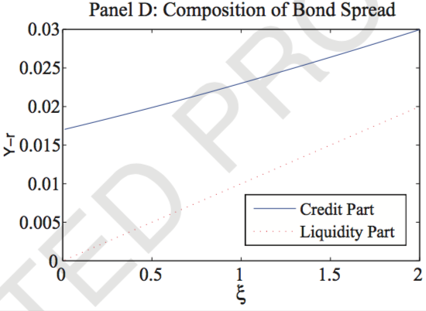
III. Market Liquidity and Endogenous Default
B. Liquidity Premium and Default Premium
PROPOSITION 2: All else equal, an increase in bond holders’ liquidity shock intensity ξ decreases the firm’s bond price and increases equity holders’ default boundary VB.
Figure 2. Effects of bond investors’ liquidity demand intensity. This figure uses the base- line parameters listed in Table I. Panel A depicts equity holders’ aggregate rollover loss per unit of time, d(Vt,m;VB)− p, which has the same scale as the firm’s fundamental; Panel B depicts their default boundary VB; Panel C depicts the credit spread of the firm’s newly issued bonds; and Panel D decomposes the credit spread into two components, the liquidity premium ξ k and the remaining default premium. All the panels are with respect to ξ.
Notes:
Figure 2 demonstrates the effects of an increase in ξ on the firm’s rollover loss, endogenous default boundary, and credit spread by fixing other parame- ters as given in Table I. Panel A depicts equity holders’ aggregate rollover loss per unit of time d (Vt , m; VB) − p against ξ . The line shows that the magnitude of rollover loss increases with ξ . That is, as bond holders’ liquidity shock inten- sity increases, the increased liquidity premium makes it more costly for equity holders to roll over the firm’s maturing bonds. Panel B shows that the firm’s default boundary VB consequently increases with ξ. In other words, when bond market liquidity deteriorates, equity holders will choose to default at a higher fundamental threshold. We formally prove these results in Proposition 2.
Panel C of Figure 2 depicts the credit spread of the firm’s newly issued bonds against ξ, and shows that it increases with ξ. More specifically, as ξ increases from one to two, the credit spread increases from 330 basis points to 499.6. Panel D further decomposes the bond spread into two components. One is the liquidity premium ξk, which, as shown by the dotted line, increases linearly with ξ. The residual credit spread after deducting the liquidity premium cap- tures the part of the credit spread that is related to the firm’s default risk. We call this component the default premium. Interestingly, the solid line shows that the default premium also increases with ξ. This result is in line with our earlier discussion: by raising the firm’s default boundary, deterioration in bond market liquidity also increases the default component of the firm’s credit spread. Specifically, as ξ increases from one to two, the liquidity premium rises by 100 basis points while the default premium increases by 69.6 basis points (which contributes to 41% of the total credit spread increase).

Slide 12
III. Market Liquidity and Endogenous Default
B. Liquidity Premium and Default Premium
Under the different sets of parameters that are used to generate Figure 2, default damages the joint interest of debt and equity holders because even in the absence of any bankruptcy costs
It is an issue of conflict of interest :
When the bond price falls (even for liquidity reasons), equity holders have to bear all of the rollover losses to avoid default while maturing debt holders are paid in full.
Notes:
Formally Mathmatically proved,….

Slide 13
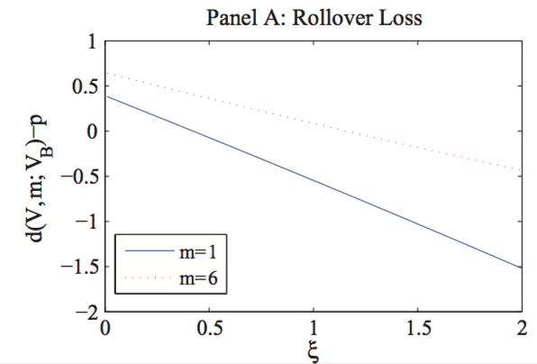
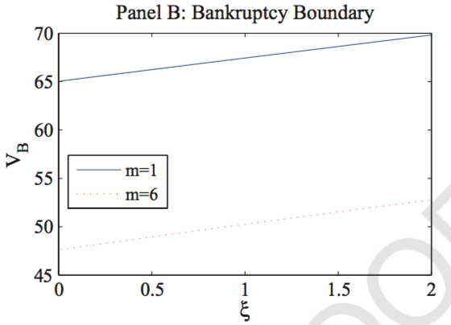
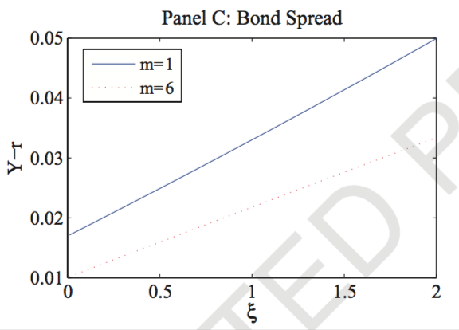
III. Market Liquidity and Endogenous Default
C. Amplification of Short-Term Debt
A shorter debt maturity for the firm implies a higher rollover frequency. a higher rollover frequency forces equity holders to absorb a greater rollover loss per unit of time. This means a higher cost of keeping the firm alive, which in turn motivates equity holders to default at a higher fundamental threshold.
Notes:
A standard intuition suggests that shorter debt maturity for an individual bond leads to lower credit risk. However, shortening the maturities of all bonds issued by a firm intensifies its rollover risk and makes it more vulnerable to deterioration in market liquidity. According to our model, a shorter debt maturity for the firm implies a higher rollover frequency. Directly from the rollover loss expression d(Vt, m) − P/m, if the market value of the firm’s newly issued bonds d(Vt,m) is below the principal of maturing bonds P/m, a higher rollover frequency forces equity holders to absorb a greater rollover loss per unit of time. This means a higher cost of keeping the firm alive, which in turn motivates equity holders to default at a higher fundamental threshold.
To illustrate this maturity effect, we compare two otherwise identical firms, one with debt maturity of 1 year and the other with debt maturity of 6 years. Note that the second firm has the same fundamental, coupon payment, and face value of debt as the first firm; in other words, we do not calibrate its credit spread to any benchmark level. As a result, this firm is different from the calibrated BB-rated firm with 6-year debt maturity in Section III.D.
Figure 3 demonstrates the different impacts of a change in ξ on these two firms with different maturities. Panel A shows that as bond investors’ liquid- ity shock intensity ξ increases, both firms’ rollover losses (per unit of time) increase. More importantly, the rollover loss of the firm with shorter debt ma- turity increases more than that of the firm with longer maturity. Panel B further confirms that while both firms’ default boundaries increase with ξ , the boundary of the shorter maturity firm is uniformly higher. Panel C shows that as ξ increases from one to two, the credit spread of the shorter maturity firm ncreases by 170 basis points from 330 to 500, while that of the longer maturity firm increases only by 119 basis points from 215 to 334. As these firms share the same liquidity premium in their credit spreads, the difference in the changes in their credit spreads is due to the default component of credit spread

Slide 14
III. Market Liquidity and Endogenous Default
C. Amplification of Short-Term Debt
heavy use of short-term debt financing by many financial institutions leading up to the crisis.
In the months preceding its bankruptcy, Lehman Brothers was rolling over 25% of its debt every day through overnight repos, a type of collateralized lending agreement with an extremely short maturity of 1 day.
Short-term debt can significantly amplify a firm’s rollover risk and make it vulnerable to shocks to bond market liquidity. Our model thus highlights firms’ debt maturity structure as an important determinant of credit risk.
Notes:
Take advantage of this discussion to understand financial crisis

Slide 15
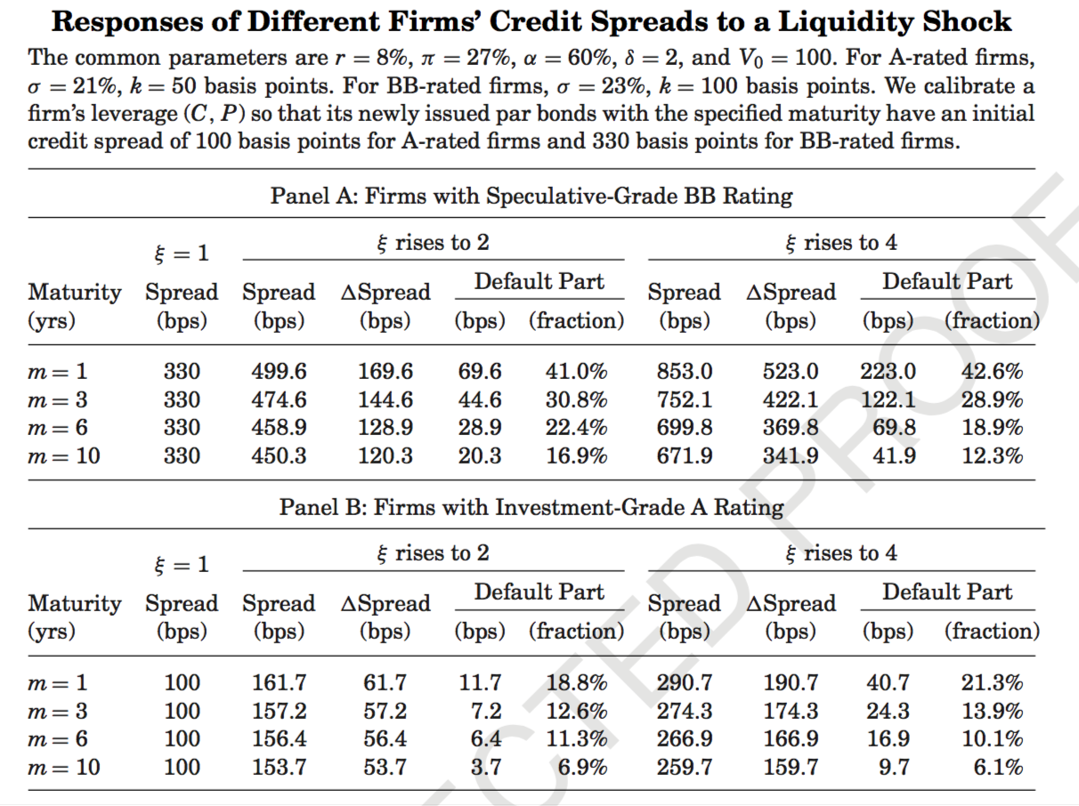
III. Market Liquidity and Endogenous Default
D. Calibration of Different Firms
Notes:
Formally prove it
Our model shows that liquidity premia and default premia are intertwined and work together in determining firms’ credit spreads. In particular, an in- crease in liquidity premium can exacerbate default risk and make firms with weaker fundamentals more susceptible to default risk. To illustrate this effect, we compare responses of a set of firms with different credit ratings and debt maturities to the same liquidity shock represented by an increase in ξ. This exercise also allows us to show that deterioration in market liquidity can have a significant effect on the credit risk of a variety of firms through debt rollover.
We focus on firms with two particular credit ratings: investment-grade A and speculative-grade BB. For each credit rating, we consider firms with four different debt maturities: m = 1, 3, 6, and 10. We let these firms share the same baseline values given in Table I for interest rate r, debt tax benefit rate π, bankruptcy recovery rate α, payout rate δ, current firm fundamental V0, and investor liquidity shock intensity ξ. We let A-rated firms have fundamental volatility σ = 21% and bond trading cost k = 0.5%, while BB-rated firms have σ = 23% and k = 1.0%. For each A-rated firm, we calibrate its leverage (i.e., coupon payment C and face value of debt P) so that the firm issues new bonds at par and these bonds have a credit spread of 100 basis points at issuance. For each BB-rated firm, we calibrate its leverage so that its newly issued par bonds have a credit spread of 330 basis points. These parameter choices are discussed in Section III.A.
For each of the firms, Table II reports its bond spread when ξ = 1 (the base- line), 2, and 4, together with the total spread change from the baseline and the part caused by increased default risk. As ξ changes from one to two, the liquidity premium doubles from 100 basis points to 200 for the credit spread of a BB-rated firm and from 50 to 100 for that of an A-rated firm. Similarly, As ξ changes from one to four, the liquidity premium quadruples. According to Bao et al. (2011), the trading costs of corporate bonds more than quadrupled during the recent financial crisis. We thus interpret the change of ξ from one to two as a modest shock to market liquidity and from one to four as a severe crisis shock.
Table II shows that the credit spreads of BB-rated firms are more sensitive to the same shock to market liquidity than those of A-rated firms. Furthermore, for a given debt maturity, increased default risk contributes to a greater fraction of the credit spread increase for the BB-rated firm. This is because the weaker BB-rated firm is closer to its default boundary and thus more vulnerable to any increase in default boundary caused by the shock to market liquidity.

Slide 16
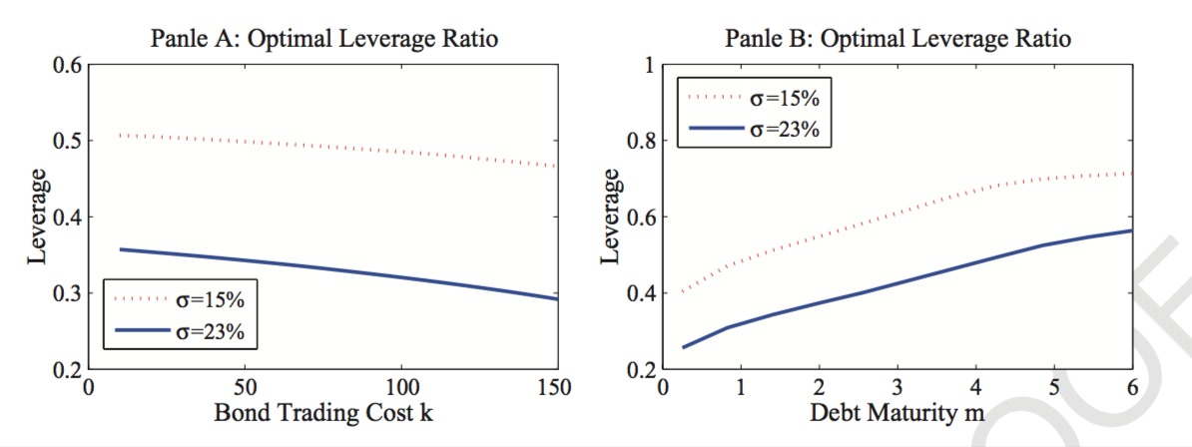
IV. Optimal Leverage
the debt market becomes more illiquid, the firm’s default risk rises, which in turn motivates the firm to use lower leverage.
it is optimal to use a lower leverage for shorter debt maturity.
Notes:
Given the substantial impact of market liquidity on the firm’s credit risk, it is important for the firm to incorporate this effect in its initial leverage choice at t = 0. We now discuss the firm’s optimal leverage.
In analyzing the firm’s optimal leverage, we focus on the effects of three model parameters: bond trading cost k, debt maturity m, and the firm’s asset volatility σ. Figure 4 depicts the firm’s optimal leverage with respect to bond trading cost k (Panel A) and debt maturity m (Panel B) for two firms, one with asset volatility σ = 15% and the other with σ = 23%. Both panels show that the optimal leverage of the firm with the lower asset volatility is uniformly higher than that of the other firm, because the former firm can afford to use a higher leverage due to its smaller credit risk.
Panel A shows that the optimal leverage of both firms decreases with bond trading cost. As k increases from 10 to 150 basis points, the optimal leverage of the firm with the higher asset volatility drops from 35.7% to 29.2%. This pattern is consistent with the key insight of our model that as the debt market becomes more illiquid, the firm’s default risk rises, which in turn motivates the firm to use lower leverage.
Panel B shows that each firm’s optimal leverage increases with its debt ma- turity. As m increases from 0.25 to six, the optimal leverage of the firm with 23% asset volatility increases from 25.6% to 56.4%. This pattern is again con- sistent with our earlier result that short-term debt amplifies firms’ rollover risk. As a result, it is optimal to use a lower leverage for shorter debt ma- turity.

Slide 17
V. Conclusions
A model to analyze the effects of debt market liquidity on a firm’s credit risk through its debt rollover.
When a shock to market liquidity pushes down a firm’s bond prices, it amplifies the conflict of interest between debt and equity holders because, to avoid bankruptcy, equity holders have to absorb the firm’s losses from rolling over maturing bonds at the reduced market prices.
Our model highlights the role of short-term debt in amplifying a firm’s rollover risk
Notes:
Formally prove it

Slide 18
V. My opinion
Mostly agree with the paper. But one part concerns me. Recall:
Panel D decomposes the credit spread into two components, the liquidity premium ξ k and the remaining default premium. All the panels are with respect to ξ.
Isn’t setting the remaining to be default premium too discretional? Any other risk factors to identify?
‘Collin-Dufresne, Goldstein, and Martin (2001) find that proxies for changes in the probability of future default based on standard credit risk models and for changes in the recovery rate can only explain about 25% of the observed changes in credit spread. On the other hand, they find that the residuals from these regressions are highly cross-correlated, and that over 75% of the variation in the residuals is due to the first principal component. The source of this systematic component still remains unclear. Our model sug- gests that aggregate shocks to the liquidity of bond markets are a possible candidate.’
Notes:
Formally prove it

